Slide 1
ABINAYA A.
821721104001
BE COMPUTER SCIENCE AND ENGINEERING
SIR ISSAC NEWTON COLLEGE OF ENGINEERING
AND TECHNOLOGY

Slide 2
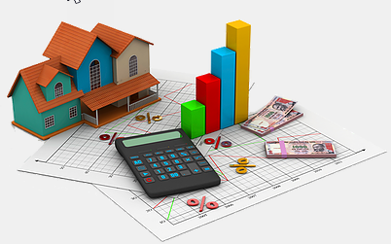
HOUSE PRICE PREDICTION (ANN)

Slide 3


AGENDA
House price prediction is a crucial aspect of the real estate industry, enabling homeowners, buyers, sellers, and investors to make informed decisions. It involves utilizing various data points and predictive models to estimate the value of residential properties accurately. With the increasing availability of data and advancements in machine learning techniques, house price prediction has become more precise and reliable than ever before.
1. Introduction : Overview of the project goals.
2. Data Collection and Preprocessing : Gathering relevant dataset.
3. Model Architecture Design : Determine the structure.
4. Data Splitting : Splitting the data.
5. Model Training : Training the ANN using the training dataset.
6. Model Evaluation : Accessing the performance of the trained model.
7. Hyperparameter Tuning : Optimizing hyperparameter.
8. Model Validation : Assessing the generation performance.
9. Deployment : Deploying the trained ANN model.
10. Monitoring and Maintenance : Setting up monitoring systems.
3/21/2024 Annual Review

Slide 4

PROBLEM STATEMENT
The problem of house price prediction using Artificial Neural Networks (ANN) arises from the need to accurately estimate the value of residential properties based on various attributes. The objective is to develop a predictive model that can leverage the power of neural networks to analyze complex relationships within the data and make precise predictions of house prices.
The ultimate goal of addressing this problem is to provide stakeholders in the real estate industry with a valuable tool for making data-driven decisions, whether it's pricing properties accurately, assessing market trends, identifying investment opportunities, or facilitating transactions effectively. By leveraging Artificial Neural Networks for house price prediction, the aim is to achieve higher prediction accuracy and better capture the nuances of property valuation in dynamic real estate markets.

Slide 5

PROJECT OVERVIEW
Title: House Price prediction
Objective: The objective of house price prediction is to accurately estimate the value of a property based on various factors such as location, size, amenities, market trends, and historical data. This is valuable for buyers, sellers, and real estate professionals to make informed decisions about buying, selling, or investing in properties.

Slide 6
WHO ARE THE END USERS?
The end users of house price prediction models are typically homebuyers, real estate agents, property investors, financial institutions, government agencies, app developers, and researchers.
They utilize these predictions for various purposes such as estimating fair market value, advising on pricing strategies, identifying investment opportunities, assessing lending risk, informing policy-making, enhancing user experiences in real estate apps, and conducting research on housing market trends

Slide 7

YOUR SOLUTION AND ITS VALUE PROPOSITION
Solution: Artificial Neural Networks (ANNs) are commonly used for house price prediction due to their ability to handle complex relationships between input features and output predictions.
Value Proposition: The value proposition of house price prediction lies in its ability to empower stakeholders with valuable insights, optimize decision-making processes, and contribute to the efficiency and effectiveness of the real estate industry as a whole.
It's important to continuously monitor and fine-tune the model's performance to ensure its effectiveness and relevance in predicting house prices accurately.

Slide 8

THE WOW IN YOUR SOLUTION
.
The wow factor in the solution of house price prediction using Artificial Neural Networks (ANNs) lies in its capability to harness the power of advanced machine learning techniques to accurately predict house prices based on a multitude of input features.
The wow factor in using ANNs for house price prediction lies in their ability to deliver accurate, scalable, and adaptive solutions that revolutionize decision-making processes in the real estate industry, ultimately providing tremendous value to all stakeholders involved
.
3/21/2024 Annual Review

Slide 9
MODELLING
Modeling house price prediction involves several steps, typically using machine learning techniques.
The modeling process, it's essential to iterate, experiment, and refine the model based on feedback and new data to ensure its accuracy and relevance in predicting house prices effectively.
The modeling process, it's important to experiment, iterate, and fine-tune the ANN based on performance feedback to ensure accurate and reliable predictions of house prices.
.

Slide 10
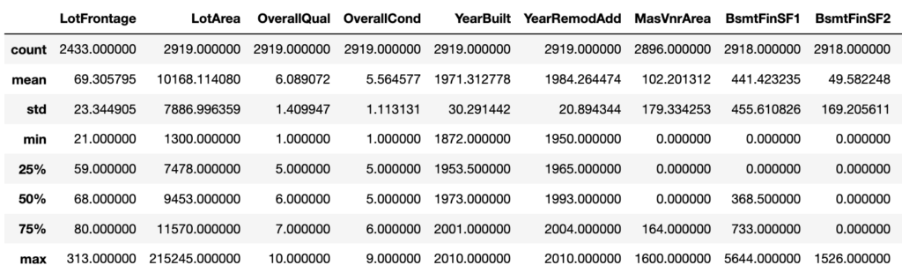
RESULTS
HOUSE PRICE PREDICTION USING ANN
n

